Slide 1

Visualizing and Exploring Data

Slide 2
Cross-Tabulations
A cross-tabulation is a tabular method that displays the number of observations in a data set for different subcategories of two categorical variables.
A cross-tabulation table is often called a contingency table.
The subcategories of the variables must be mutually exclusive and exhaustive, meaning that each observation can be classified into only one subcategory, and, taken together over all subcategories, they must constitute the complete data set.

Slide 3
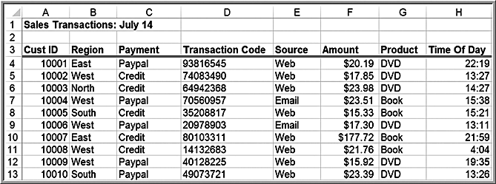
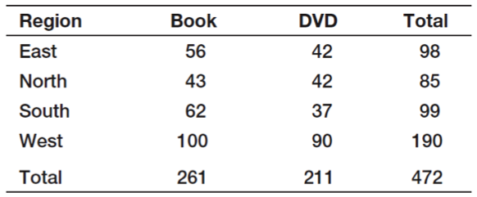
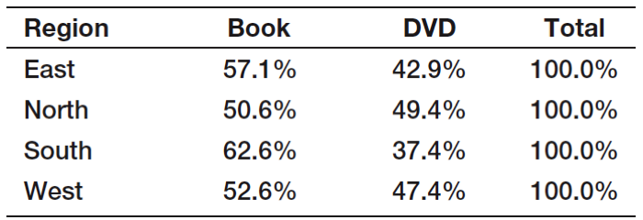
Example 3.26: Constructing a Cross-Tabulation
Sales Transactions database
Count the number (and compute the percentage) of books and DVDs ordered by region.

Slide 4
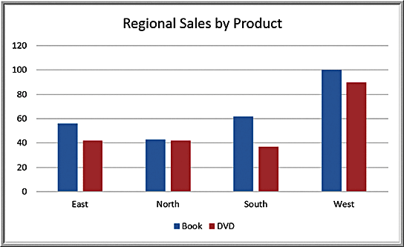
Cross-Tabulation Visualization: Chart of Regional Sales by Product

Slide 5
Exploring Data Using PivotTables
Excel provides a powerful tool for distilling a complex data set into meaningful information: PivotTables.
PivotTables allows you to create custom summaries and charts of key information in the data.
PivotTables can be used to quickly create cross-tabulations and to drill down into a large set of data in numerous ways.

Slide 6
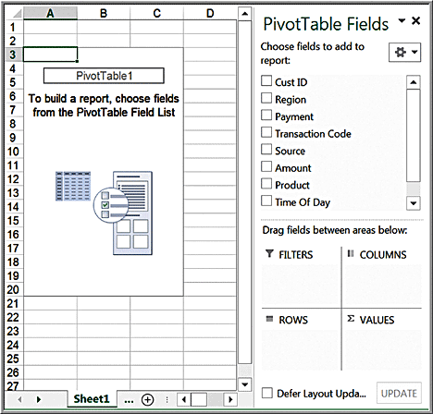
Constructing PivotTables
Click inside your database
Insert >
Tables >
PivotTable
The wizard creates a blank PivotTable as shown.

Slide 7
PivotTable Field List
Select and drag the fields to one of the PivotTable areas:
Report Filter
Column Labels
Row Labels
Σ Values

Slide 8
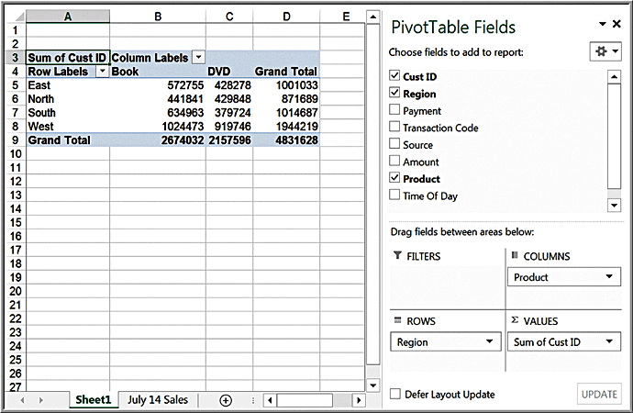
Example 3.27 Creating a PivotTable
Initial PivotTable for Regional Sales by Product
The PivotTable defaults to a sum of the field in the Values area.
We seek a count of the number of records in each category.

Slide 9
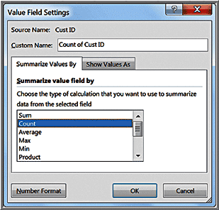
Changing Value Field Settings
Active Field > Analyze >
Field Settings
Change summarization
method in Value Field
Settings dialog box
Select Count

Slide 10
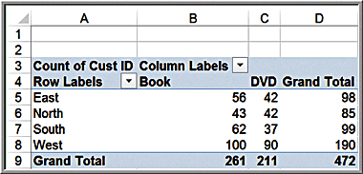
Final Pivot Table

Slide 11
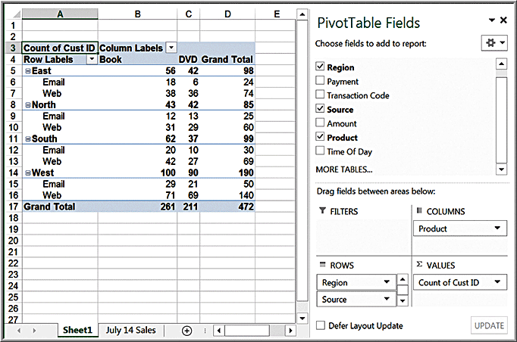
Modifying PivotTables
Uncheck the boxes in the PivotTable Field List or drag the field names to different areas.
You may easily add multiple variables in the fields to create different views of the data.
Example: drag the Source field into the Row Labels area

Slide 12
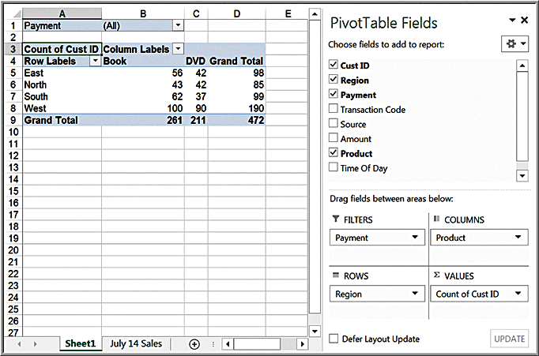
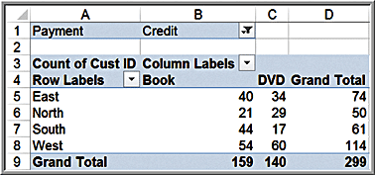
Example 3.28: Using the PivotTable Report Filter
Dragging a field into the Report Filter area in the PivotTable Field list allows you to add a third dimension to your analysis.
Click the drop down arrow in cell B1; choose Credit:

Slide 13
PivotCharts
PivotCharts visualize data in PivotTables.
They can be created in a simple one-click fashion.
Select the PivotTable
From the analyze tab, click PivotChart.
Excel will display an Insert Chart dialog that allows you to choose the type of chart you wish to display.

Slide 14
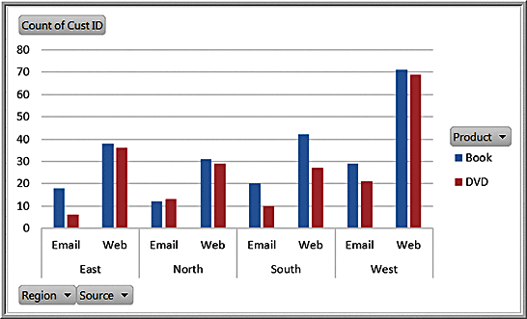
Example 3.29: A PivotChart for Sales Data
By clicking on the drop-down buttons, you can easily change the data that are displayed. by filtering the data. Also, by clicking on the chart and selecting the PivotChart Tools Design tab, you can switch the rows and columns to display an alternate view of the chart or change the chart type entirely.

Slide 15
Slicers
Excel 2010 introduced slicers — tools for drilling down to “slice” a PivotTable and display a subset of data.
To create a slicer for any of the columns in the database, click on the PivotTable and choose Insert Slicer from the Analyze tab in the PivotTable Tools ribbon.

Slide 16
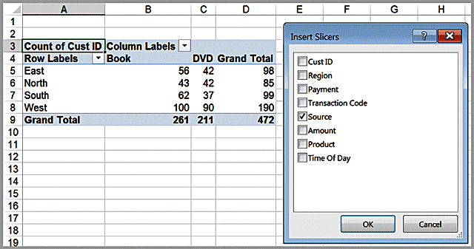
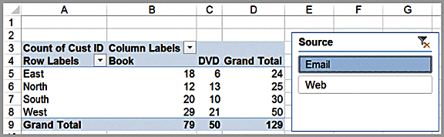
Example 3.30 Using Slicers
Cross-tabulation “sliced” by E-mail

Slide 17
PivotTable Dashboards
The camera tool is useful for creating PivotTable-based dashboards.
If you create several different PivotTables and charts, you can easily use the camera tool to take pictures of them and consolidate them onto one worksheet.
In this fashion, you can still make changes to the PivotTables and they will automatically be reflected in the camera shots.

Slide 18
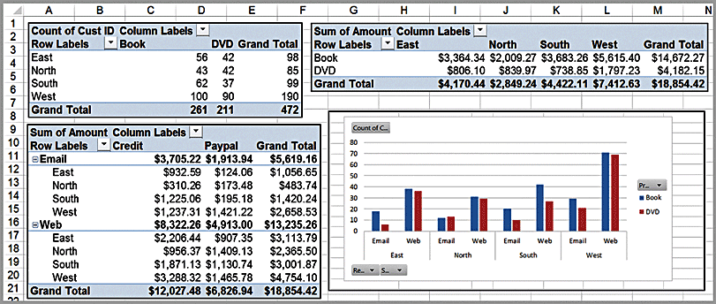
Camera-Based Dashboard Example

